Slide 1
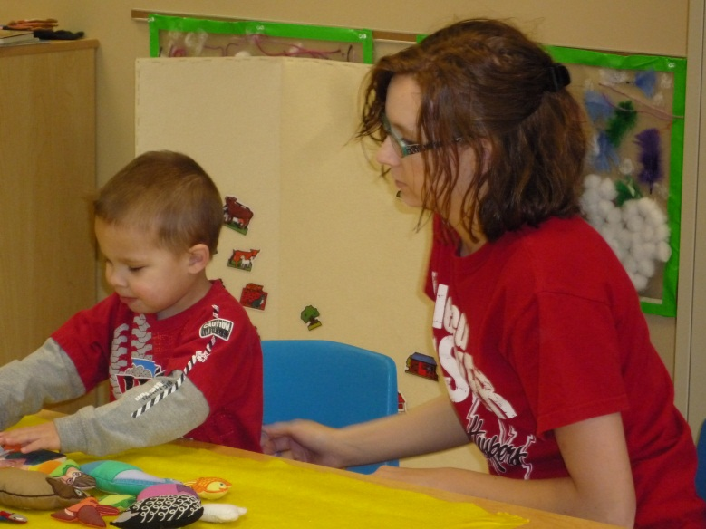
Sixpence Annual Report 2013
Prepared by Barb Jackson, Ph.D.
Rosie Zweiback, M.A.
Interdisciplinary Center For Program Evaluation

Slide 2
Who were the children and families served?
342 Children
311 Families
22 Pregnant Moms
Notes:
Hit clicker 3 times for 3 animations
Similar to 2011-2012
(345 children 331 families 23 pregnant mothers)
This Year:
60% represented minority backgrounds
52% female, 48% male
74% under 1

Slide 3
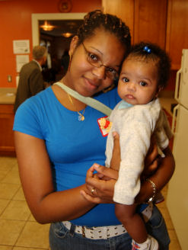
What were the top Sixpence risk factors?
83%
63%
56%
50%
Poverty
Single Parents
Teen Parents
No High School Diploma
Notes:
Celebration: By June, 44 mothers had earned their diploma or GED and 33 mothers were still enrolled in high school or working towards the GED (based on 92 surveys)
This year we looked at new risk factor – CPS involvement and removal from home – 7 Sixpence children were removed from home.
7% premature birthrate – (decrease of 11-12 – 9%)

Slide 4
What percent of higher risk families has Sixpence served over time ?
Percent of Families with Three or More Risk Factors
67%
62%
2011-2012
2012-2013
Notes:
High risk children is still more than in first year of Sixpence when rate was 56%

Slide 5
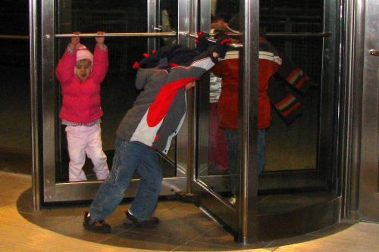
What was the retention rate of families in the program?
73% of the children stayed for the entire program year.
Of 342 children served:
63% were in 1st year
26% were in 2nd year
11% were in 3rd year
Nearly half of the children who exited the program mid-year
were six months of age or younger.
Notes:
Click 4 times for 4 animations –
This year shows an increase of children in 2nd (20% 2011-12)or 3rd year 10% (2011-2012)

Slide 6
How has the retention of families changed over time?
Sixpence Retention Rates Over Time
73%
67%
Percent of children
2011-2012
2012-2013
Notes:
Click 2 times for 2 animations –

Slide 7
Implications….
What strategies can Sixpence Programs use to hold on to their youngest children?
Identify strategies to
engage families with infants
in the program long term
Notes:
Animation….three slide

Slide 8
What was the quality of the center-based services?
Key Finding: Overall, the center-based classroom environments were of high quality with the majority of classrooms meeting the standards for quality.
Key Finding: Sixpence teachers have improved in the use of instructional support strategies that promote learning.
Notes:
Review that Quality includes classroom environment, materials, teacher-child interaction, routines, parent involvement etc. plus instructional support strategies.
The eval team did In person observations of 15 classrooms across all 6 programs with center based care (Lincoln, Omaha, Santee, Macy, Walthill, Crete, alliance)

Slide 9
How has classroom quality changed over time?
Percent of Classrooms Meeting Quality Standards
on Every Subscale
86%
67%
2011-2012
2012-2013
Notes:
ITERS: ITERS overall mean=6.05, and 6 of 7 classrooms met the benchmarks on all 7 subscales

Slide 10
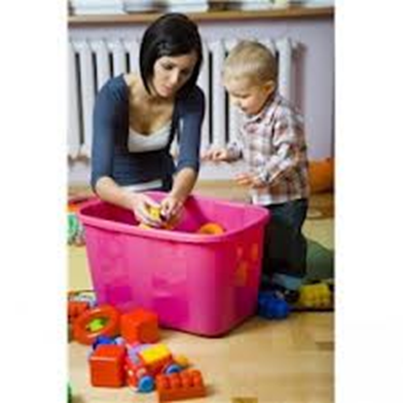
How has instructional quality changed over time?
Average Instructional Support Scores Over Time
7
15% Increase
5.12
4.43
1
2012-2013
Notes:
8 classrooms were assessed – scores went up 15%. Scale is 1-7. 1-2 is low quality, 3-5 is medium quality, 6-7 is high quality
Pianta research says instructional support scores at 3.5 impact child outcomes

Slide 11
Implications…..
What can Sixpence programs do to further support children’s learning?
Target continuous improvement activities on instructional learning:
Concept Development
Quality Feedback
Language Modeling
Notes:
So we have established that we have high quality environments, strong teacher-child relationships, but an area for improvement is instructional learning as demonstrated in CLASS scores

Slide 12
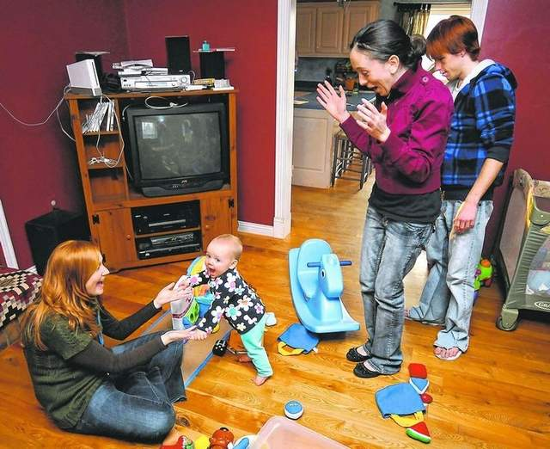
What was the quality of family engagement services?
Key Finding: Family engagement services are of high quality and result in engaged parents and children.

Slide 13
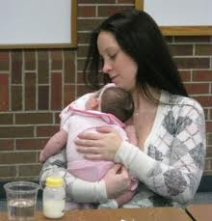
What was the quality of home visit instruction?
Quality of Home Visit Instruction
5
4.55
4.15
3
1
Home Visit Instruction
Parent/Child Engagement
Notes:
HoVers – 7 subscales collapsed into two. 5 point scale
N = 11
Scores were slightly higher in engagement in 2012
Slightly lower in HV instruction in 2012
Compared to 2011

Slide 14
What were the children’s developmental outcomes?
Key Finding: The majority of the children met or exceeded the widely held expectations by spring, with strengths in the areas of cognitive, fine motor and social emotional development
Key Finding: The majority of children met or exceeded the expected growth rate for their age.

Slide 15
What were the developmental outcomes by Spring?
Notes:
Strengths ranged from 95-96 %
Math lowest 78%
Literacy and Language 85-86%
Growth 72-96 % with math and cognitive having the lowest 72 and 73%

Slide 16
What were the children’s language outcomes?
Key Finding: The majority of the infants and toddlers demonstrated typical language production and comprehension skills across the year; skills did not change significantly from fall to spring.

Slide 17
What were the children’s language skills by spring?
Notes:
Similar patterns in 2009

Slide 18
What were the children’s language outcomes in the area of vocabulary?
Key Finding: Toddlers demonstrated significant gains in vocabulary skills with the majority meeting age-level expectations.
Key Finding: Child risk factors and home language were linked to vocabulary outcomes.

Slide 19
How did the children’s vocabulary development change over time?
Significant increase (p<.001, d=.63)
Mean Standard Score
102
94
Fall
Spring
Notes:
Three clicks to bring in animation P =.001 d=1.42
No significant difference in 2009
No differences between groups – N is small ELL or frl status
74% in mid average range
N=18
In 2009 skills declined.

Slide 20
What was the impact of time in program on the children’s language?
Time in the program did not impact child language outcomes.
Notes:
NOTE that there were no significant differences across demographics– child outcomes in the area of language did NOT vary based on demographic variables such as poverty, English language learners etc…

Slide 21
How did family risk factors impact vocabulary?
Additional
Risk Factor
For every
Point drop in
Vocabulary Scores
There was a
p =.004
Notes:
Regression was completed….. (n=37; slope =-4.033; r²=-.366; p=.004).

Slide 22
How did home language affect vocabulary?
Significant Difference p<.001
104
Mean Standard Score
88
English as a Second Language
English Speaking
Notes:
Three animations – three clicks
SR n=96
Self regulation was .019 d=.24
In 2009 started lower and showed significant changes across all areas.

Slide 23
What were the social-emotional outcomes of the children?
Key Finding: The majority of children met age expectations across social-emotional dimensions.
Key Finding: Participation in Sixpence resulted in significant improvements in social-emotional protective factors.
Notes:
87% score in med-range or higher for TPF
81% - NO behavior concerns

Slide 24
How did the children’s Total Protective scores change from fall to spring?
Significant Increase p<.001, d=.28
105
Mean Standard Score
100
Fall
Spring
Notes:
Three animations – three clicks
SR n=96
Self regulation was .019 d=.24
In 2009 started lower and showed significant changes across all areas.

Slide 25
Implications……
What can Sixpence programs do to increase support for children’s developmental outcomes?
Target continuous improvement activities to support development by:
Increasing curriculum opportunities in math, language, & literacy
Coaching parents
Enhancing classroom practices

Slide 26
What were the health outcomes for the children?
Key Finding: Sixpence families met or exceeded the state health indicators.

Slide 27
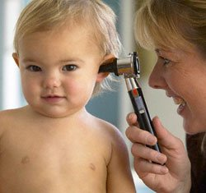
What percent of Sixpence children met established health indicators?
% of Children Meeting Established Health Indicators
96%
97%
94%
88%
Car Seat Use
Well Child Checks
Medical Home
Immunizations
Notes:
Click four times for animation
2012 data n=212,
Car seat 94%
Well child 92%
Medical home 95%
Immunizations 94%

Slide 28
What were the health outcomes for pregnant mothers?
Key Finding: Pregnant mothers enrolled in Sixpence met or exceeded the majority of state health indicators for prenatal care with the exception of a slightly lower rate of abstinence from smoking.
Notes:
23 pregnant mothers served this year – 11 still unborn

Slide 29
What were the health outcomes for pregnant mothers?

Slide 30
How did participation in Sixpence impact parenting?
Key Finding: Sixpence helped families close the gap in creating a positive home environment to support their children’s cognitive and emotional development.

Slide 31
How did parenting change from fall to spring?
Notes:
2009-2010
88-95

Slide 32
How did Sixpence Programs impact parent-child interaction skills?
Key Finding: Sixpence families demonstrated adequate parent-child interaction skills.
Key Finding: Families demonstrated higher quality interactions with their children the longer they were in Sixpence.

Slide 33
What were the parent-child interaction skills demonstrated in the spring?

Slide 34
What factors impacted parent-child interactions?
1
Teen parents demonstrated significantly lower skills than adult-aged parents ( p<.004, small to medium effect ).
2
The longer the parent was in the program, the higher the quality of the interaction skills (p=<.001, large effect).

Slide 35
Implications….. How can family engagement providers support parents in enhancing their children’s learning skills and build the parent’s confidence in their interactional skills?
Family engagement providers could:
Identify strategies to keep families engaged in program
Build parents’ skills to support children’s learning and confidence.
Examine their coaching interactions

Slide 36
Reflections and Questions

